Slide 1
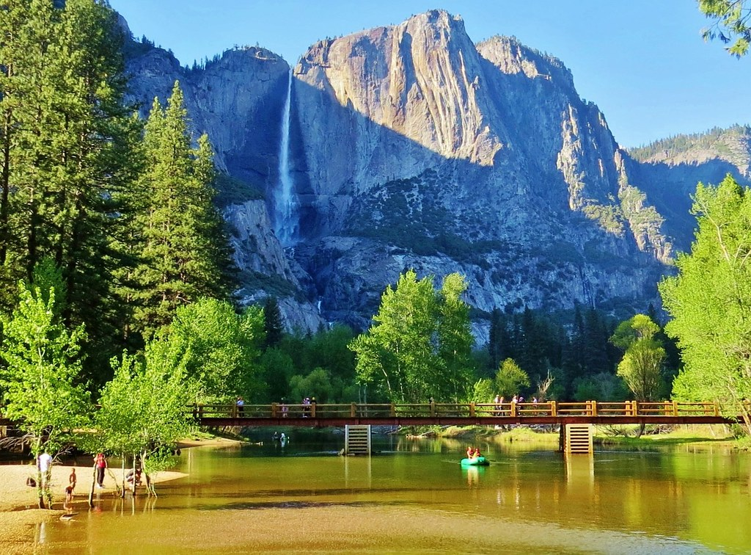
Summertime Fun
Team Icebreaker

Slide 2


Slide 3
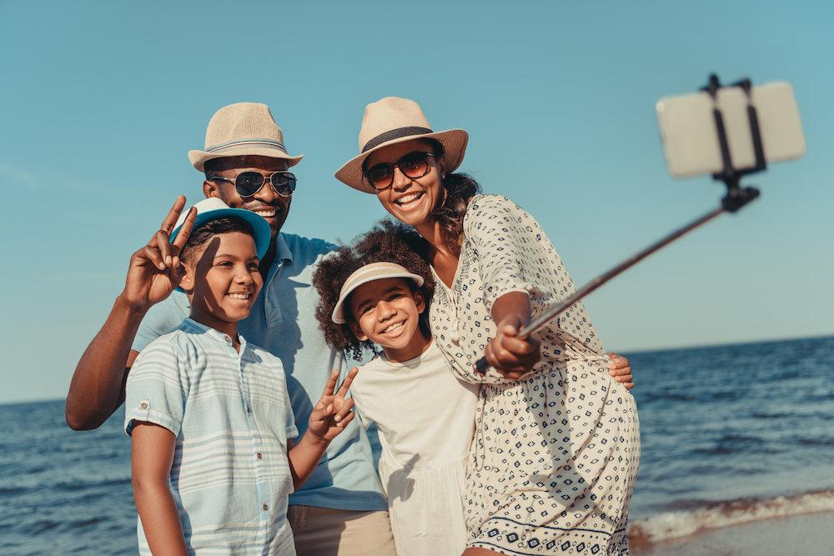
Guess Who:
Question 1
Who vacationed in beautiful Ocean Isle, NC with their family this summer?
Amy Smith
Jennifer Jones
Mike Williams
Erica Swanson

Slide 4

Guess Who: Question 2
Whose husband gifted her with a nice vacation to the Virgin Islands?
Lisa Jackson
Michelle Davison
Bethany Silver
Alice Lane

Slide 5
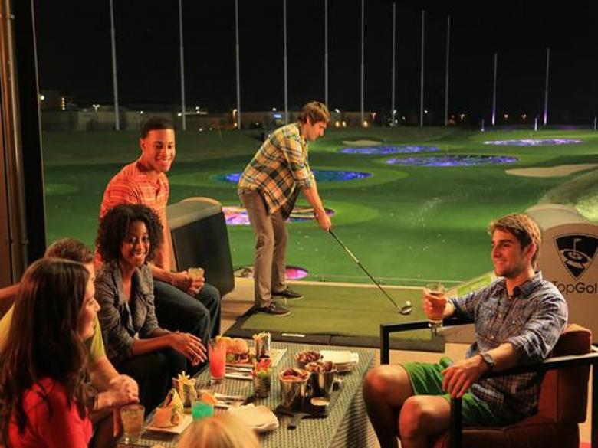
Guess Who:
Question 3
Who traveled to see their friends in Houston where they visited Top Golf and enjoyed practicing their golf swing along with food, games, and drinks?
Melissa Thompson
Francesca Morin
Olivia Neal
Steven Beck

Slide 6
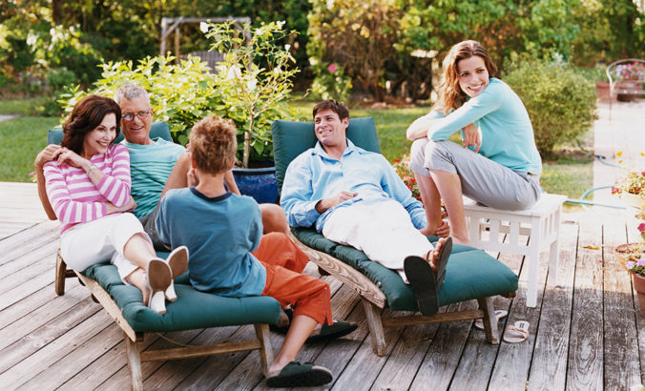
Guess Who: Question 4
Who spent a lot of time on their deck this summer with family enjoying the outdoors and grilling?
Jim McKenna
Tommy Dodd
Kevin Hooper
Louis Clark

Slide 7

Guess Who:
Question 5
A few team members from which company department enjoyed a dinner outing this summer?
A. HR
B. Accounting
C. IT
D. Marketing

Slide 8

Travel Trivia:
Which is the number ONE vacation spot in the U.S.?
A. New York City, NY
B. Grand Canyon, AZ
C. Maui, HI
D. Washington, DC
This Photo by Unknown Author is licensed under CC BY-NC

Slide 9

Guess Who: Question 6
Whose daughter enjoyed her first BBQ this summer?
A. Jasmine Andrews
B. Christopher Jackson
C. Gavin Singleton
D. Karen Lee

Slide 10
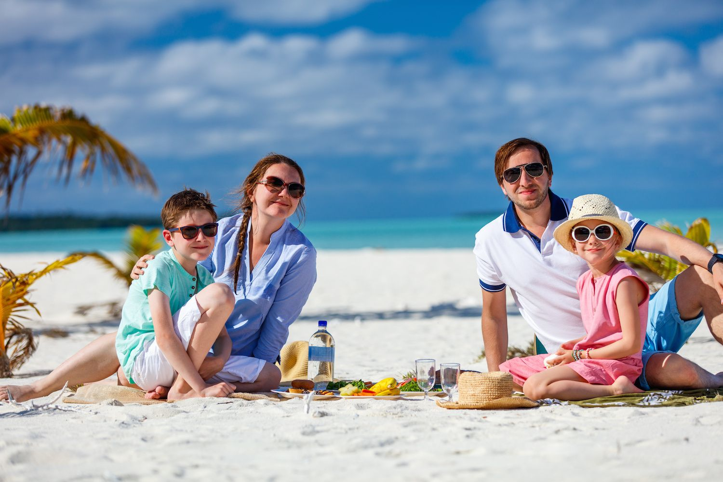
Guess Who: Question 7
Who enjoyed beach time with their family in Mexico this summer?
A. Elise Dickens
B. Deon Williams
C. Billy Sanders
D. Jessica Smith

Slide 11

Guess Who:
Question 8
Whose cute little fur baby, Roscoe, had a fun summer?
A. Corrine Rees
B. Jamie Howells
C. Nicole Murphy
D. James Sharpe

Slide 12
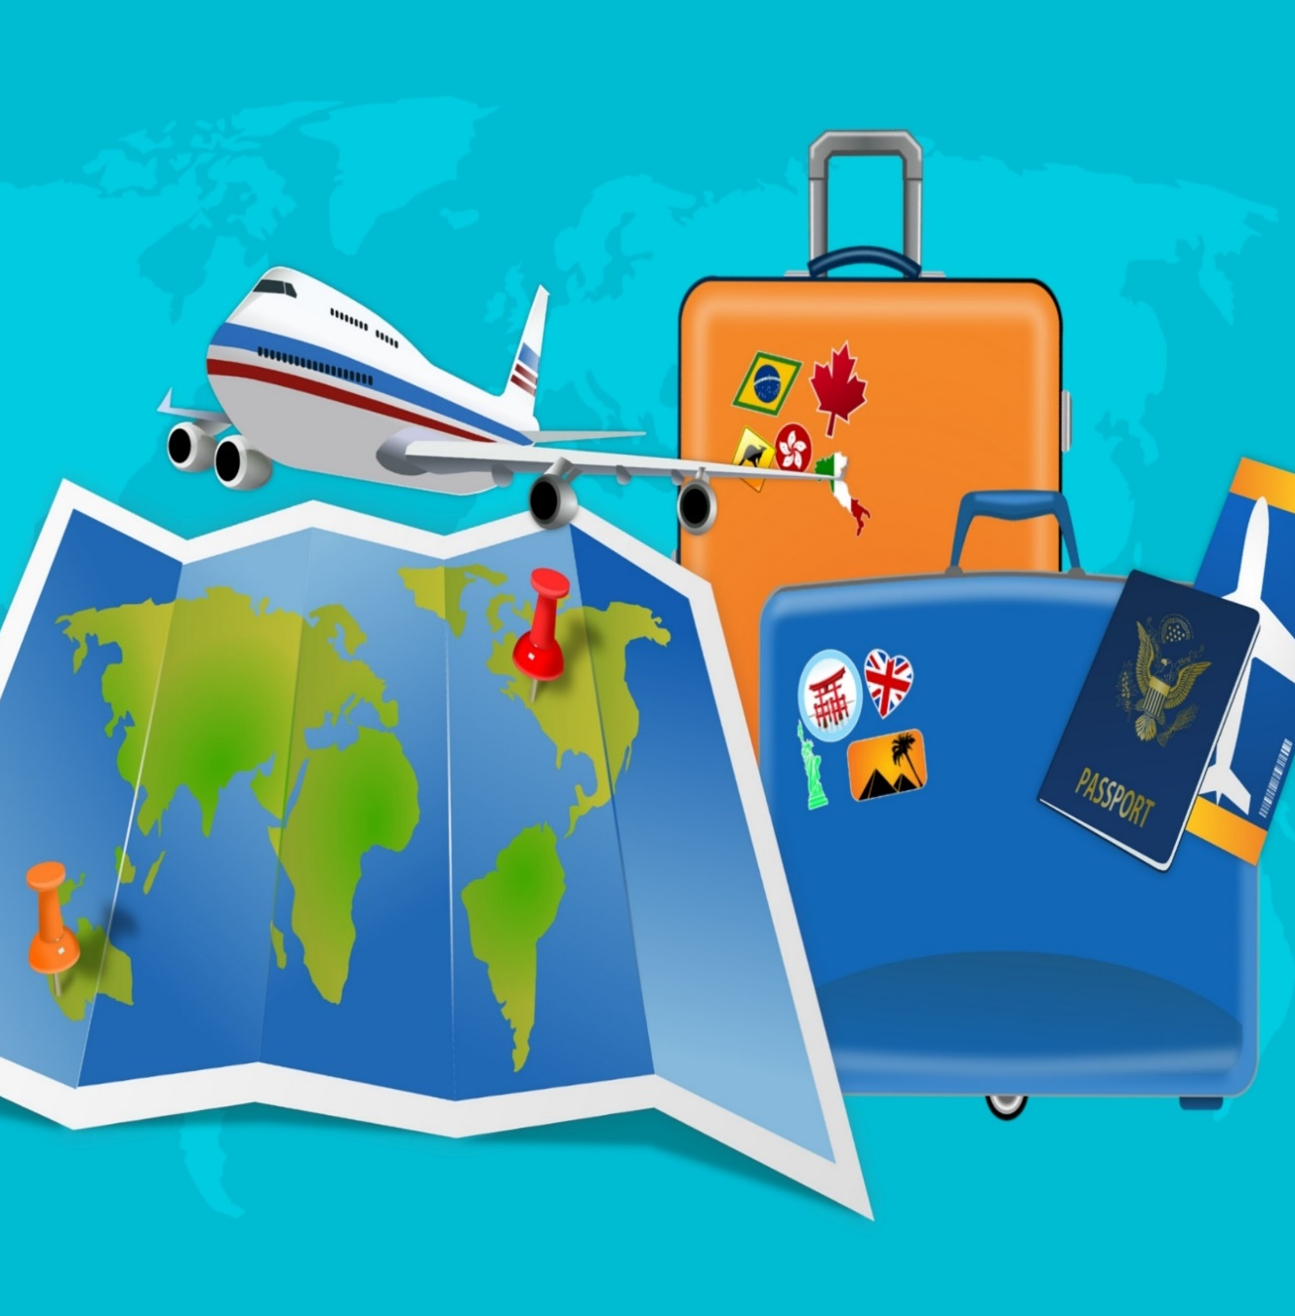
Travel Trivia:
Which is the number ONE vacation spot in the world?
A. Bora Bora, French Polynesia
B. Paris, France
C. South Island, New Zealand
D. Great Barrier Reef, Australia
This Photo by Unknown Author is licensed under CC BY-NC

Slide 13
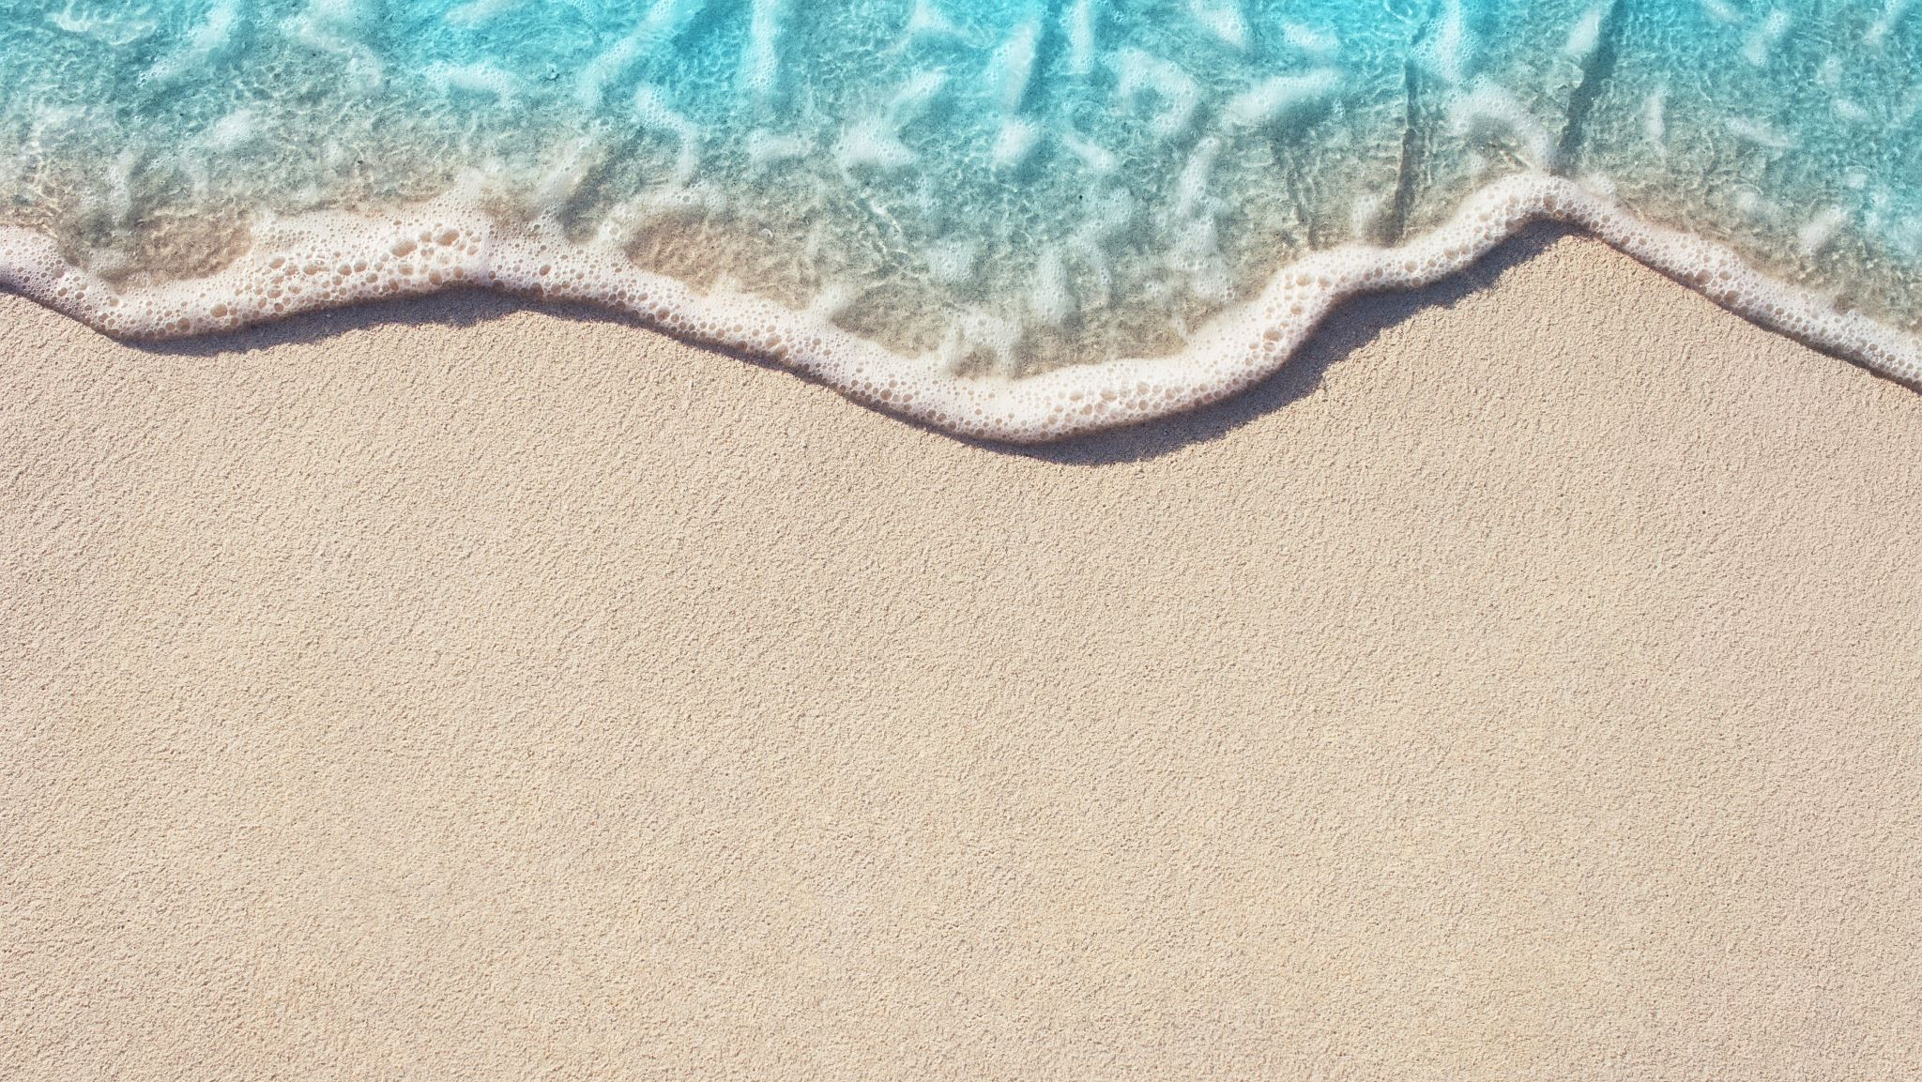
Enjoy the Rest of Your Summer!

